Slide 1
Laws and Regulations
Notes:
Notes
Laws are the actual legislation, whereas regulations are rules enforced by a regulatory agency such as the USDOE

Slide 2
Section Overview
Family Educational Rights and Privacy Act
Children’s Online Privacy Protection Act
Protection of Pupil Rights Amendment
Health Insurance Portability and Accountability Act
New York State Education Law 2-d
Student Privacy Pledge
Notes:
Notes
The Student Privacy Pledge is not a law. It is a pledge signed by many companies in response to data security and privacy concerns. More details later.

Slide 3
Family Educational Rights and Privacy Act - FERPA
Background | Federal law enacted in 1974 to protect student education records, or personally identifiable information (PII) from student education records, from unauthorized disclosure.
Applies To | Schools that receive funds under any program administered by the U.S. Secretary of Education
Key Provisions | Parents have the right to access their children’s education records, the right to seek to have the records amended, and the right to consent to disclosure. Parents also have the right to file a complaint with the U.S Department of Education.
Additional Info | When a student turns 18 years old, or enters a postsecondary institution at any age, FERPA rights transfer from the parents to the student (they become an eligible student).
http://www2.ed.gov/policy/gen/guid/fpco/doc/ferpa101slides.pdf
Notes:
Notes
The charts in the presentation will break down key points of the laws, but see additional resources for details.
Education records are defined as records that are directly related to a student, and maintained by an educational agency or institution or by a party acting for the agency or institution.
Full text of FERPA at https://www.law.cornell.edu/uscode/text/20/1232g

Slide 4
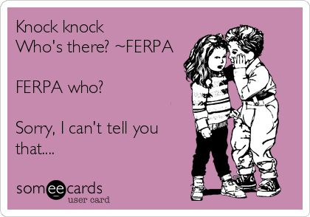

Slide 5
Personally Identifiable Information (PII)
Per FERPA, PII includes but is not limited to:
Student's name
Name of the student's parent or other family members
Address of the student or student's family
A personal identifier, such as the student's social security number, student number, or biometric record
http://www.ecfr.gov/cgi-bin/text-idx?rgn=div5&node=34:1.1.1.1.33#se34.1.99_13
Notes:
Notes
Definitions of PII vary among laws. The current and next slides define PII as per FERPA.
NYS Education Law 2-d uses the same definition.

Slide 6
Personally Identifiable Information
Other indirect identifiers…
Student’s date of birth
Student’s place of birth
Mother’s maiden name
Other information that…
Alone or in combination is linked or linkable to a specific student
Would allow a reasonable person in the school community, who does not have personal knowledge of the relevant circumstances, to identify the student with reasonable certainty
Information Requested by a Person…
Who the educational agency or institution reasonably believes knows the identity of the student to whom the education record relates
http://www.ecfr.gov/cgi-bin/text-idx?rgn=div5&node=34:1.1.1.1.33#se34.1.99_13

Slide 7
Personally Identifiable Information (PII)
More generally, PII is information such as a student’s name or identification number that can be harmful or embarrassing to an individual if disclosed alone or in combination with certain other information.
Notes:
Notes
As laws vary, and the definitions can be vague, this is a general, simple way to think about PII.
You may encounter other definitions which use different acronyms such as PPSI (Personal, Private & Sensitive Information) and SPII (Sensitive, Personally Identifying Information)
Whether PII is sensitive can depend on context.

Slide 8
FERPA Exceptions
Two key exceptions to FERPA PII disclosure restrictions are:
Directory Information
School Official Exception (includes administrators, instructors and school board members)
Notes:
Notes
The exceptions are in the absence of written consent.
Below. Is a detailed List of exceptions witch generally relate to LEAs.
To school officials with legitimate educational interests (defined in annual notification)
To schools in which a student seeks or intends to enroll
To authorized representatives of Federal, State, and local educational authorities conducting an audit, evaluation, or enforcement of education programs.
To State and local officials pursuant to a State statute in connection with serving the student under the juvenile justice system;
To organizations conducting studies for specific purposes on behalf of schools;
To accrediting organizations; – to parents of a dependent student;
To comply with a judicial order or subpoena (reasonable effort
To notify parent or student at last known address); – in a health or safety emergency;
Directory information.

Slide 9
Directory Information
Directory Information is PII that is typically not considered harmful or an invasion of privacy if disclosed on its own. For example:
Name
Address
Telephone Number
Date of Birth
Grade Level
Sports and Activity Participation
School Photo
Notes:
Notes
Directory information is information contained in the education records of a student that would not generally be considered harmful or an invasion of privacy if disclosed. Typically, "directory information" includes information such as name, address, telephone listing, date and place of birth, participation in officially recognized activities and sports, and dates of attendance. A school may disclose "directory information" to third parties without consent if it has given public notice of the types of information which it has designated as "directory information," the parent's or eligible student's right to restrict the disclosure of such information, and the period of time within which a parent or eligible student has to notify the school in writing that he or she does not want any or all of those types of information designated as "directory information." 34 CFR § 99.3 and 34 CFR § 99.37.
Source: http://ptac.ed.gov/glossary/eligible-student

Slide 10
Directory Information
Schools may disclose directory information to third parties without consent if:
Public notice is given about the data designated as directory information
A reasonable time period for parents/eligible students to opt out is provided
Notes:
Notes
Drawbacks of the Directory Information exception to FERPA:
Only data designated can be provided to third parties
An imbalance can be created if some parents or students opt out.

Slide 11
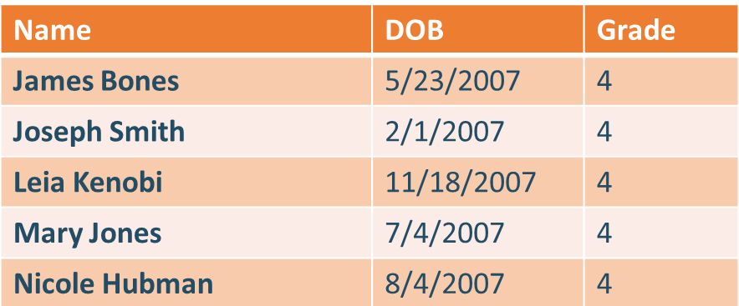
Example: Directory Information
This data could be disclosed without consent if defined as directory
information and the parents have not opted out:

Slide 12
Directory Information
Example uses of directory information provided by districts:
Newsletters
Awards Ceremonies
Website
Yearbooks
Concert Programs
News Media

Slide 13
School Official Exception
PII may also be disclosed without consent under the School Official Exception. If the disclosure is to a third party such a contractor or consultant to whom the district has outsourced district services or functions, the provider must:
Perform a service or function for which the school system would otherwise use its own employees
Have a legitimate educational interest in the education records as determined by the school district and defined by policies and annual notices to parents
Be “under the direct control of the school system with regard to the use and maintenance of education records,” typically established through a contract between the parties
Only use the education records for the purposes for which the disclosure was made and may not re-disclose the records to any other person or party without prior written consent of parents or eligible students
Adapted from Protecting Privacy in Connected Learning Toolkit Version 2, September 2014 - CoSN
Notes:
Notes
A school official has a legitimate educational interest if the official needs to review an education record in order to fulfill his or her professional responsibility.
The School Official Exception is also what allows information to be shared by teachers, such as records reviewed when a student moves from 5th grade to 6th grade.
Another Example: A district can provide info to a provider that allows parents and students to verify cafeteria accounts balances and meals. The provider cannot see the information to a third party, of use the data to target advertisements. (See COSN Toolkit)

Slide 14
Example: School Official Exception
Disclosure of this data could occur under the School Official Exception:
Name | Student ID | DOB | Grade | FRL Status | SPED | ELA 3 Level
James Bones | 246813579 | 5/23/2007 | 4 |  | No | Level 4
Joseph Smith | 987654320 | 2/1/2007 | 4 | Free | No | Level 3
Leia Kenobi | 371503715 | 11/18/2007 | 4 |  | Yes | Level 3
Mary Jones | 987654310 | 7/4/2007 | 4 |  | Yes | Level 2
Nicole Hubman | 517316384 | 8/4/2007 | 4 | Reduced | No | Level 2
Notes:
Notes
Note that this data is PII combined with education record data. Release could be harmful or embarrassing.

Slide 15
FERPA Exceptions
Two more exceptions to FERPA PII disclosure restrictions are:
Studies
Developing, validating or administering predictive tests
Administering student aid programs
Improving instruction
Audits or Evaluations
Audits or evaluations of Federal or State-supported education programs
Enforcement or compliance with Federal legal requirements related to the program
Notes:
Notes
Brief mention of two more of the exceptions. Also see FERPA Exceptions_HANDOUT_horizontal_0.pdf

Slide 16
Can a Student ID be Directory Information?
Yes …if it cannot be used to gain access to education records without the use of other factors to authenticate the user’s identity, such as a password or PIN.
Note: Opt out rights cannot be used to prevent a requirement to display a Student ID card or badge that contains information properly designated as directory information.
Notes:
Notes
This is a more recent addition
See http://www2.ed.gov/policy/gen/guid/fpco/doc/ferpa101slides.pdf

Slide 17
COPPA

Slide 18
Children’s Online Privacy Protection Act - COPPA
Background | Enforced by the Federal Trade Commission since 2000 to give parents control over information collected from young children online
Applies To | Operators of websites, online services and mobile applications
Key Provision | COPPA assures that children under 13 years of age do not share personal information on the Internet without the express approval of their parents.
Additional Info | COPPA rules were amended in 2013. The amendments, among other things, expand the definition of personal information, require data deletion and retention procedures, and clarify the direct notification requirements to parents. (Do not track kids act 2015?)
https://www.law.cornell.edu/uscode/text/15/chapter-91
Notes:
Notes
An educational institution can consent to a website or app’’s collection, use or disclosure of personal information from students. For details on circumstances, see section M of the FTC COPPA FAQ at www.ftc.gov/tips-advice/business-center/guidance/complying-coppa-frequently-asked-questions
As noted in the FAQ, best practice is to provide parents with notice of the websites and online services whose collection it has consented to on behalf of parents.
Full text of COPPA at https://www.law.cornell.edu/uscode/text/15/chapter-91
Additional Information
Examples of Online Service (from above FAQ)
Services that allow users to play network-connected games, engage in social networking activities, purchase goods or services online, receive online advertisements, or interact with other online content or services.
Mobile applications that connect to the Internet, Internet-enabled gaming platforms, voice-over-Internet protocol services, and Internet-enabled location-based services also are online services covered by COPPA.
COPPA defines personal information as follows: (from above FAQ)
First and last name;
A home or other physical address including street name and name of a city or town;
Online contact information;
A screen or user name that functions as online contact information;
A telephone number;
A social security number;
A persistent identifier that can be used to recognize a user over time and across different websites or online services;
A photograph, video, or audio file, where such file contains a child’s image or voice;
Geolocation information sufficient to identify street name and name of a city or town; or
Information concerning the child or the parents of that child that the operator collects online from the child and combines with an identifier described above.

Slide 19
COPPA
Website and online service providers must give parents:
Notice before collecting personal information online from children (and obtain consent)
The choice to consent to internal use of a child’s information, but prohibiting disclosure to third parties (unless clearly defined as integral to the site or service)
Access to their child's personal information and the ability to request deletion
The opportunity to prevent further use or collection of a child's personal information
They must also:
Post a comprehensive online privacy policy describing their information practice
Meet certain data confidentiality, security and retention requirements
https://www.law.cornell.edu/uscode/text/15/chapter-91

Slide 20
Protection of Pupil Rights Amendment - PPRA
Background | Enacted in 1978 to protect the rights of students and parents of students in programs funded by the US Department of Education
Applies To | Any program funded by the United State Department of Education
Key Provisions | Schools and contractors must make instructional materials available for inspection by parents if those materials will be used in a survey, analysis, or evaluation funded by the federal government that deal with highly sensitive issues. Schools and contractors must obtain written parental consent before minor students are required to participate in any ED-funded survey, analysis, or evaluation
Additional Info | Districts must develop and adopt certain policies in consultation with parents and provide parents with notice of those policies and their rights under PPRA at least annually (Claim It!) Description
http://www2.ed.gov/policy/gen/guid/fpco/ppra/index.html
Notes:
Notes
Key idea is that written consent is needed before minor student can participate in any ED-funded survey, analysis, or evaluation that reveals information concerning:
Political affiliations;
Mental and psychological problems potentially embarrassing to the student and his/her family;
Sex behavior and attitudes;
Illegal, anti-social, self-incriminating and demeaning behavior;
Critical appraisals of other individuals with whom respondents have close family relationships;
Legally recognized privileged or analogous relationships, such as those of lawyers, physicians, and ministers; or
Income (other than that required by law to determine eligibility for participation in a program or for receiving financial assistance under such program).
Full text at https://www.law.cornell.edu/uscode/text/20/1232h
Example - Most schools do an annual survey on drugs, alcohol, etc. Consent is needed.

Slide 21
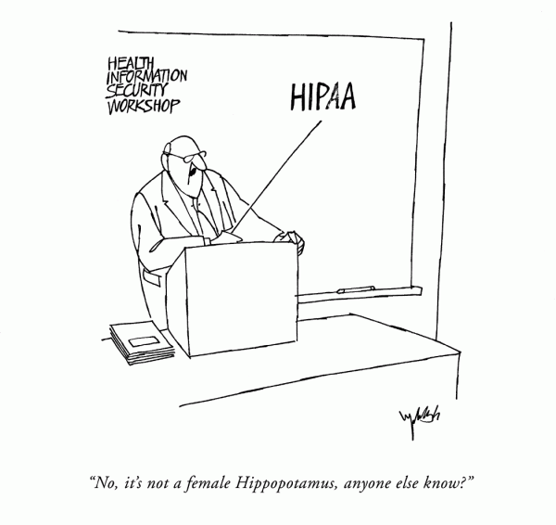
HIPAA

Slide 22
Health Insurance Portability and Accountability Act - HIPAA
Background | Federal law enacted in 1996; the Privacy Law of HIPAA adopted in 2003 regulates the use and disclosure of Protected Health Information (PHI)
Applies To | Health Care Plans Health Care Clearinghouses, and every health care provider who electronically transmits health information in connection with certain transactions
Key Provisions | Mandates administrative, technical, and physical safeguards to ensure that individual health information remains private and secure Defines the circumstances in which an individual’s protected heath information may be used or disclosed by covered entities
Additional Info | Application to K-12 schools is limited as most student records, including health records, are education records covered by FERPA
http://www.hhs.gov/ocr/privacy/hipaa/understanding/summary/privacysummary.pdf
Notes:
Notes
Example Situation: A school nurse can’t typically receive information from a doctor without authorization from parents for the doctor to release the information.

Slide 23
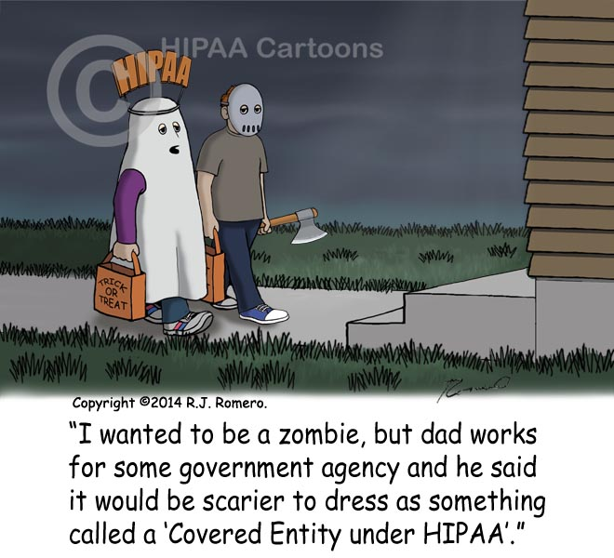
You say HIPAA, I say FERPA!
In general schools are not “Covered Entities” under HIPAA, because student health records are part of a student’s education record, and, therefore, are protected under FERPA.

Slide 24
NYS Education Law 2-d
Background | Created as part of the 2014 Common Core Implementation Reform Act to address the unauthorized release of PII from student, teacher and principal records
Applies to | Educational agencies (Districts, BOCES, NYSED) and third party contractors
Key Provisions | Chief Privacy Officer Appointment (CPO) Parents Bill of Rights for Data Privacy and Security Data Collection Transparency and Restrictions Data Security and Privacy Standards Breach and Unauthorized Release Notification Procedures Implementation and Enforcement
Notes:
Notes
Also applies to the sharing of data between educational agencies and third party contractors.
Third Party Contractor – Any person or entity, other than an educational agency, that receives student data or teacher/principal data from an educational agency pursuant to contract or other written agreement…”
We will discuss some of the provisions here. More information will come after the CPO appointment
Creating Policies, Standards and Procedures around data security and privacy
Communication

Slide 25
NYS Education Law 2-d
Chief Privacy Officer (CPO):
To be appointed by the commissioner
Shall report to the Commissioner on matters concerning data security and privacy
Will develop regulations
School districts must adopt security and privacy policies after promulgation of the regulations

Slide 26
NYS Education Law 2-d
A Parents’ Bill of Rights must be published on an educational agency’s website and shall state:
Student’s PII cannot be sold or released for commercial purposes.
Parents’ right to inspect/review education records
State and federal laws along with industry standards/best practices protect confidentiality of PII
List of student data elements collected by state available for public review
Parents’ right to review of complaints regarding breaches

Slide 27
NYS Education Law 2-d
The Parents’ Bill of Rights shall also include:
Supplemental information for each contract entered into by the educational agency with a third party contractor where such third party contractor receives student data and/or teacher/principal data.
Notes:
Notes
See Parents Bill of Rights Document on RIC Data Security and Privacy website or http://www.p12.nysed.gov/docs/parents-bill-of-rights.pdf

Slide 28
NYS Education Law 2-d
Data Collection and Transparency Restrictions:
The CPO will develop and make available a description of student, teacher and principal data collected (including explanation and/or legal authority for collection of data and its intended uses)
NYSED will collect only PII related to “educational purpose”
PII may not be sold for marketing purposes
Notes:
Notes
More information to come on Education Law 2-d regulations after the CPO appointment

Slide 29
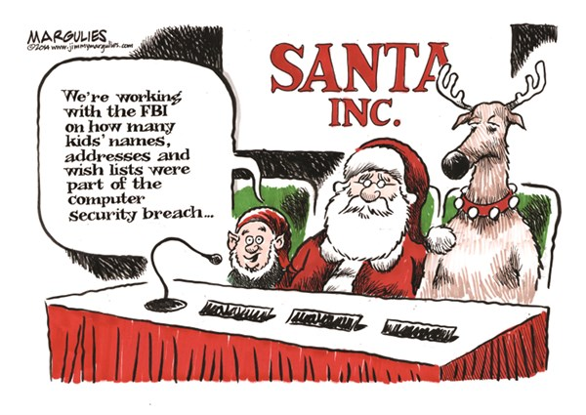
NYS Education Law 2-d
Breach and Unauthorized Release Notification Procedures:
Third party contractors must notify districts of a breach resulting in unauthorized data release.
School districts must report the breach to the CPO and any students, teachers and principals whose PII was improperly released.
Breach and unauthorized release is punishable by civil penalty and CPO can limit an offending contractors access to student, teacher and principal data.
Notes:
Notes
More information to come on Education Law 2-d regulations and enforcement after the CPO appointment

Slide 30
Student Privacy Pledge
www.studentprivacypledge.org
In 2014, the Future of Privacy Forum (FPF) and the Software & Information Industry Association (SIIA) introduced a Student Privacy Pledge to safeguard student privacy regarding the collection, maintenance, and use of student personal information.
Notes:
Notes
Many companies have shown their support for protecting student data by signing the Student Data Privacy Pledge.

Slide 31
Student Privacy Pledge
The pledge will hold school service providers accountable to:
Not sell student information
Not behaviorally target advertising
Use data for authorized education purposes only
Not change privacy policies without notice and choice
Enforce strict limits on data retention
Support parental access to, and correction of errors in, their children's information
Provide comprehensive security standards
Be transparent about collection and use of data

Slide 32
Keep Current…
Policies and procedures should be reviewed as laws and regulations change.
Notes:
Notes
Amendments to FERPA are proposed:
See http://blogs.edweek.org/edweek/DigitalEducation/2015/04/ferpa_overhaul_US_House.html
Expanded definition of what constitutes a student's "educational record"
Ban on using such information for marketing or advertising.
States and local education agencies would be subject to new requirements when contracting with vendors handling sensitive student information.
Parents would be given new opportunities to access and amend their children's data and opt out of the use of that information for research purposes.
The Student Digital Privacy Act has been proposed by President Obama in 2015.
Applies To Collection and Use of Data by Online Service Providers
Ensures that data collected in the educational context is used only for educational purposes.
Prevents companies from selling student data to third parties and from engaging in targeted advertising to students based on data collected in school.

Slide 33
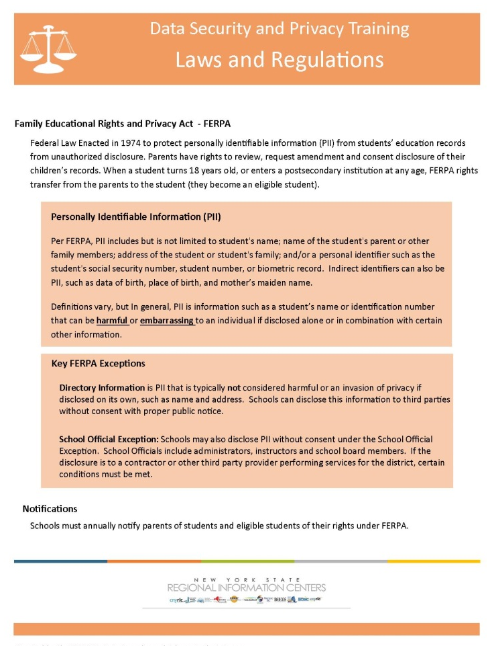
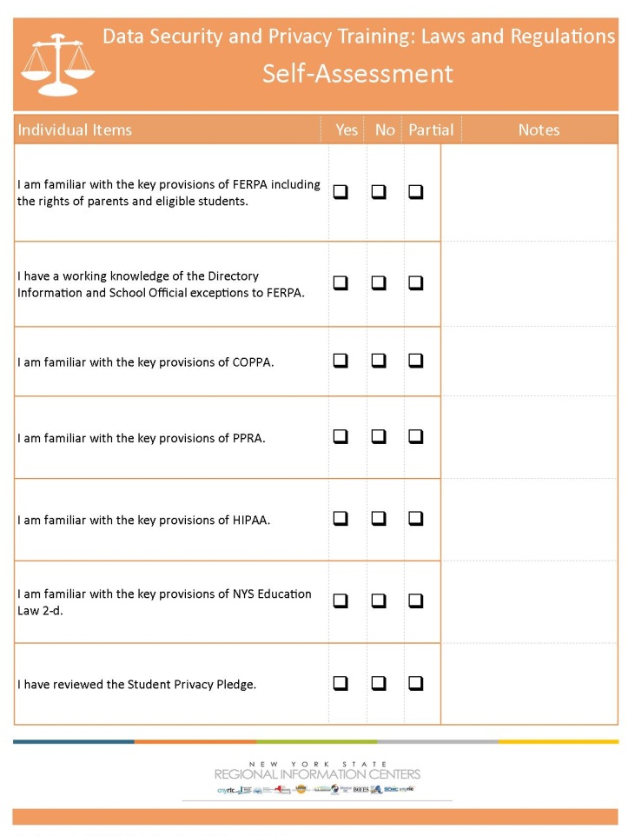
Laws and Regulations
Key Ideas
Self-Assessment
Notes:
Notes
Summarize the section and refer to the Key Ideas handout.
Self Assessments can be utilized in sessions, or as takeaways at the discretion of the presenter.

